Slide 1


Project SQL - Travel v.3
Mirko Rossi

Slide 2


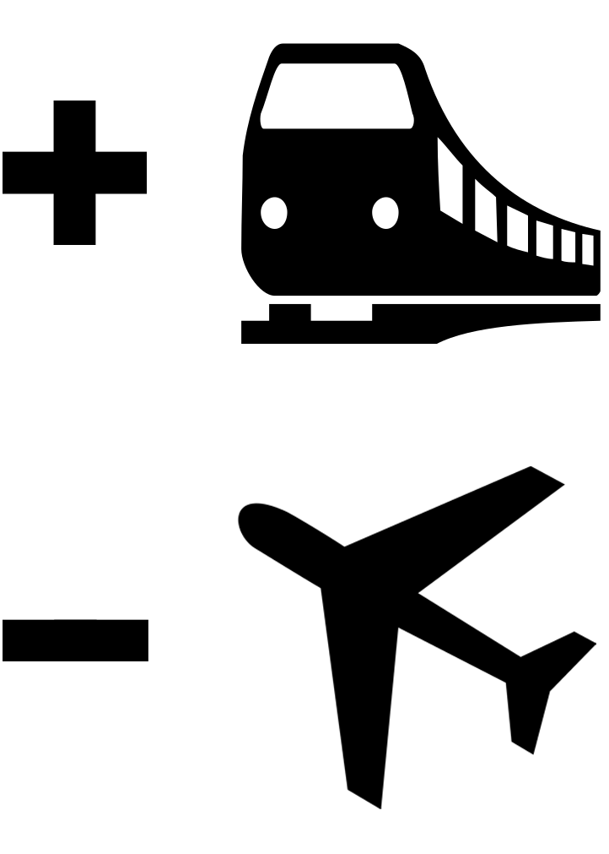
Introduction
Every year tens of thousands of people travel to other countries for business or pleasure trips, or to return to their country of origin
The US Department of State (DOS) issues, in case of emergencies, danger notices in order to alert anyone who has to physically travel abroad
The goal of this project is to extract interesting information from data for the years 2008-2016

Slide 3


Introduction
The starting data are organized in 13 tables¹ in csv format without particular descriptions
I explored the 13 tables separately, formulated hypotheses about the content of the various fields and how they could be related to each other
I chose to use PostgreSQL DBMS and the freeware DBeaver client
After creating the database and importing all the 13 tables, I performed Data Cleaning on each of them
I’m presenting the work divided by tables, even if it was often necessary to go back to the tables after having cleaned others
¹Table 13 is the second half of the btsorginus table and DBeaver automatically joined it

Slide 4
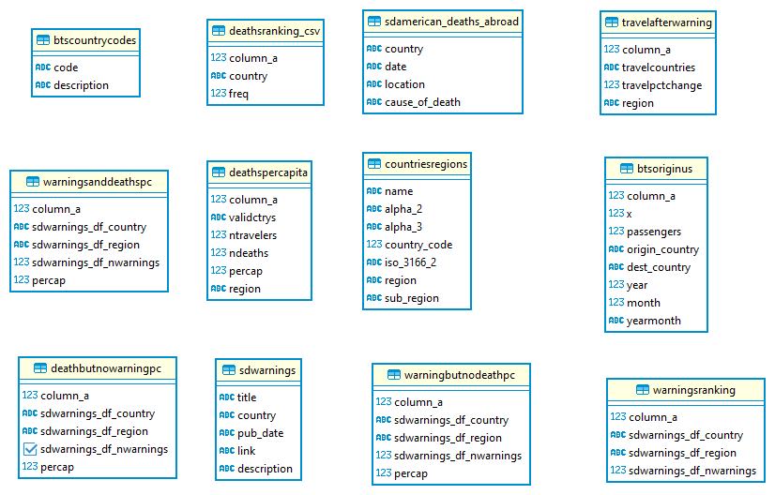
Initial tables

Slide 5
Data Cleaning

Slide 6
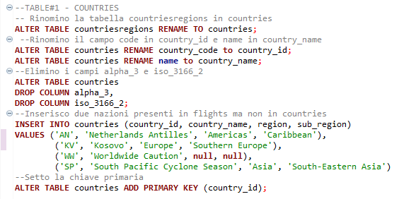
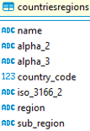
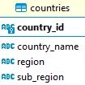
Table#1 - countries
The countries table contains the list of current nations with the related identification codes. The non-significant fields have been removed and two countries present in other tables have been integrated. At the end country_id field has been set as a primary key.

Slide 7
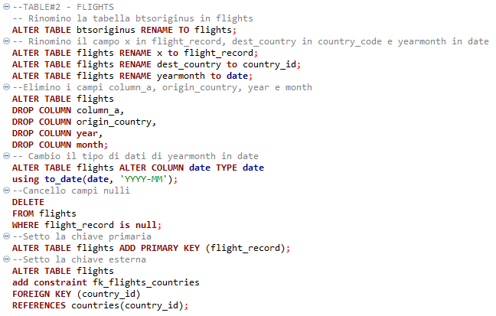
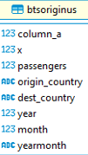

Table#2 flights
The flights table contains the register of flights departing from the USA in the period considered. Each flight is uniquely identified by a progressive number, the number of passengers, the country of destination and the date of the flight.
Here I intervened by renaming the important fields for easy reading, eliminating non-essential fields and converting the date into date format. The country_id field is foreign key from countries.

Slide 8
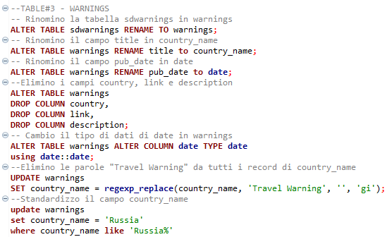


Table#3 warnings-1
The warnings table contains the register of DOS warnings with issue date and country to which it refers.
Here I intervened by creating a progressive number of the notice, setting keys and removing non-essential fields.

Slide 9
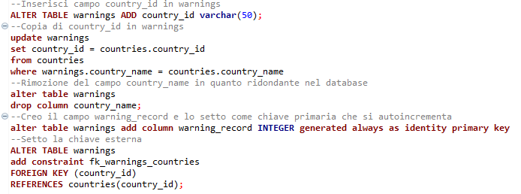
Table#3 warnings-2
I inserted a block of code, also reused for the deathpercapita and travelafterwarning tables , which creates the country_id field and imports the unique codes from countries with a JOIN, so as to have an identical foreign key in all the tables related to countries.
warning_record , has been created and set as the primary key. This made country_name non-essential and was dropped, promoting country_id to foreign key.

Slide 10
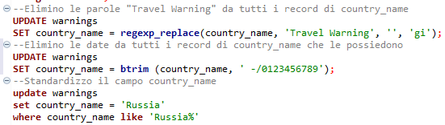
Table#3 warnings-3
Preliminary operation to the previous block was to standardize the data of the country_name field , searching and updating typos or different denominations (tot. 10 updates) and eliminating numerical values and other words that generated redundancy.

Slide 11
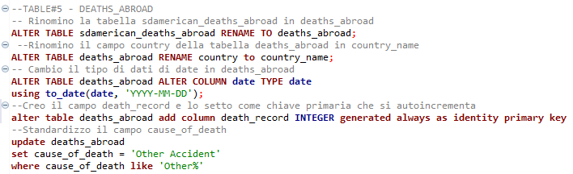
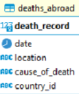
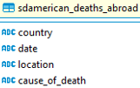
Table#4 deaths_abroad
The deaths_abroad table is a registry of American casualties abroad containing date, location, cause of death, and country of death. I changed the data type of the date field and created a unique primary key field, death_record .
I applied the block described in the "Table of warnings-2" slide by selecting country_id with a foreign key.
Each record corresponds to a single death. Similar to warnings, a lot of standardization work has been done in the cause_of_deat h field, with 15 total updates.

Slide 12
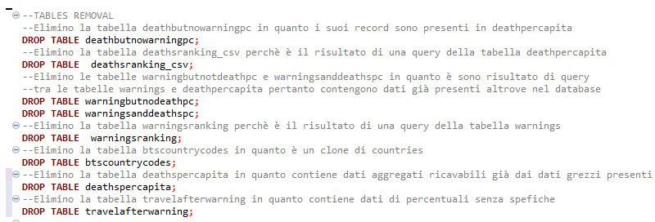
Removing useless tables
I inserted a block for removing tables containing raw or processed data present in other tables, for a total of 6 removals.

Slide 13
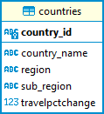
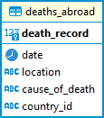
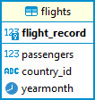

Data Cleaning diagram
1
1
are place of
are reached by
no
1
no
are targeted by
no

Slide 14
Data Analysis

Slide 15
Queries
Most visited countries
Most dangerous nations according to DOS
Safest countries according to DOS
Mortality ranking
Comparison of mortality - warnings by country
Comparison dead - warnings by season
Causes of death
Comparison terrorism - warnings by country
Comparison terrorism - warnings by season
Multiple comparison in the historical series

Slide 16
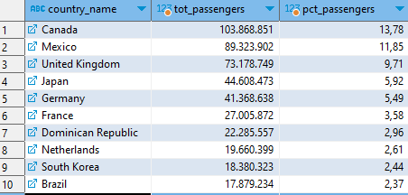
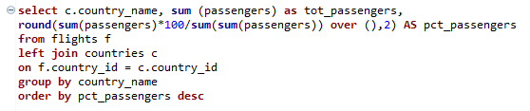
Query 1 - Most visited countries
The most visited nation is Canada with 13.78% followed by Mexico with 11.85%. Neighboring nations predictably represent destinations for 25.63% of US travelers.

Slide 17
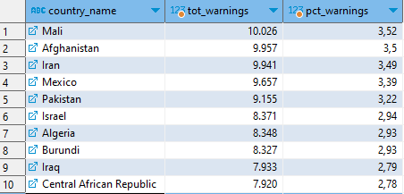
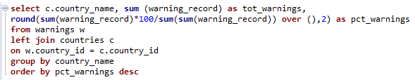
Query 2 - Most dangerous countries according to DOS
Among the nations most subject to DOS warnings are African and Middle Eastern countries with no nation emerging in the top ten positions. This list represents 31.49% of all warnings issued.

Slide 18
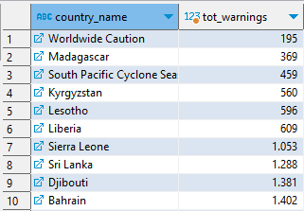
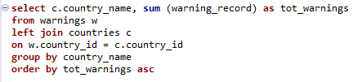
Query 3 - Most secure countries according to DOS
By ordering the previous ranking in reverse, we find that the safest country according to the ranking is Madagascar . Curiously among the safest nations are African and Middle Eastern nations, along with Kyrgyzstan in Central Asia and Sri Lanka in South Asia.
The list also carries special hazard warnings for worldwide and for cyclones in the South Pacific.

Slide 19
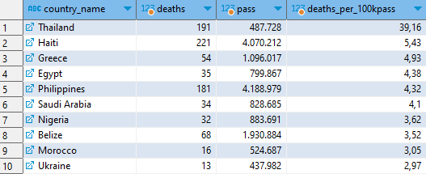
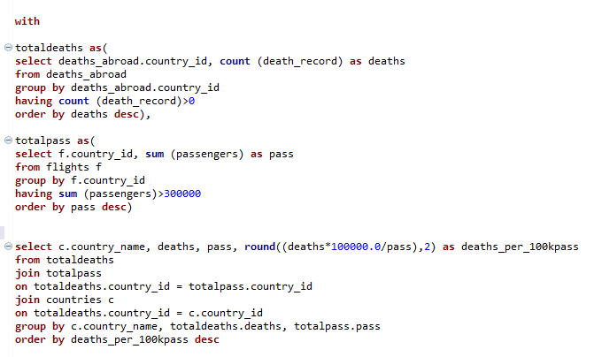
Query 4 - Mortality ranking
The country with the highest mortality is Thailand , almost 8 times the mortality of Haiti, which is in second place, having about 8 times fewer passengers. Thailand is also the country with the highest absolute death toll.
I used CTE (Common Table Expression) to pull data from the deaths_abroad and flights tables and then link them into the final table.
The list is filtered by countries visited by more than 300,000 US passengers.

Slide 20
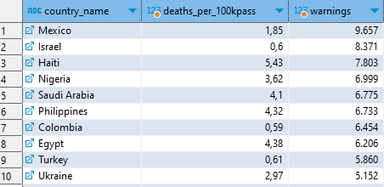
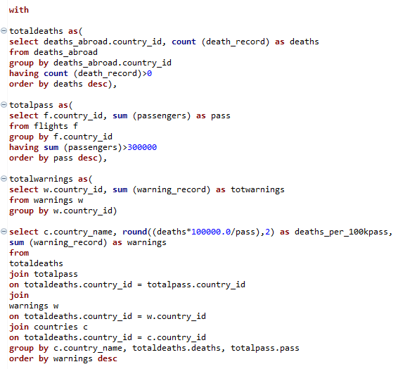
Query 5 - Comparison of mortality-warnings by country
Comparing the ranking of warnings with that of mortality, it is noted that Haiti, Nigeria, Saudi Arabia, the Philippines, Egypt and the Ukraine appear in both rankings. This indicates that warnings have been issued to the countries that are actually more dangerous.
Again I used CTE (Common Table Expression) to extract data from the deaths_abroad and flights tables and then link them into the final table.
The list is filtered by countries visited by more than 300,000 US passengers.

Slide 21
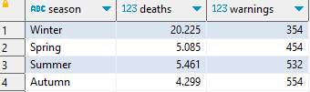
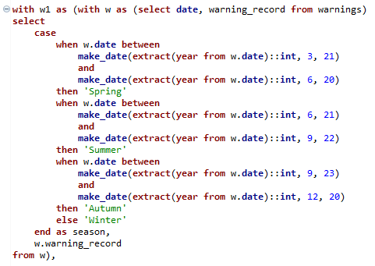
Query 6 - Comparison dead - warnings by season (1/3)
Cumulative data relating to the number of deaths per season¹, we observe a clear increase in deaths in the winter months , approximately 4-5 times compared to the other months.
Again I used CTE (Common Table Expression) to pull data from the deaths_abroad and warnings tables in d1 and w1 , then aggregating each table by season and finally merging the two tables into one final table.
¹Season are described according to boreal hemisphere

Slide 22
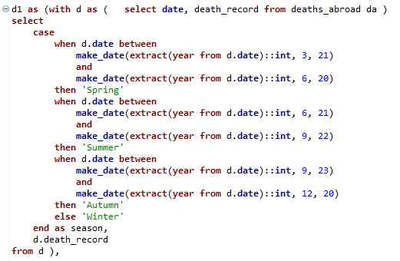
Query 6 - Comparison dead - warnings by season (2/3)
Cumulative data relating to the number of deaths per season¹, we observe a clear increase in deaths in the winter months , approximately 4-5 times compared to the other months.
Again I used CTE (Common Table Expression) to pull data from the deaths_abroad and warnings tables in d1 and w1 , then aggregating each table by season and finally merging the two tables into one final table.
¹Season are described according to boreal hemisphere

Slide 23
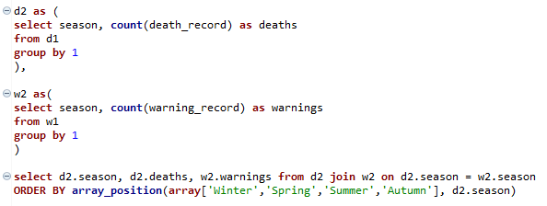
Query 6 - Comparison dead - warnings by season (3/3)
Cumulative data relating to the number of deaths per season¹, we observe a clear increase in deaths in the winter months , approximately 4-5 times compared to the other months.
Again I used CTE (Common Table Expression) to pull data from the deaths_abroad and warnings tables in d1 and w1 , then aggregating each table by season and finally merging the two tables into one final table.
¹Season are described according to boreal hemisphere

Slide 24
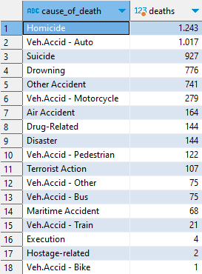

Query 7 - Causes of death
Based on the data collected, the most common cause of death is homicide , while as regards fatal accidents with vehicles, the most dangerous means is the automobile .
A non-negligible number of deaths are attributed to suicides.

Slide 25
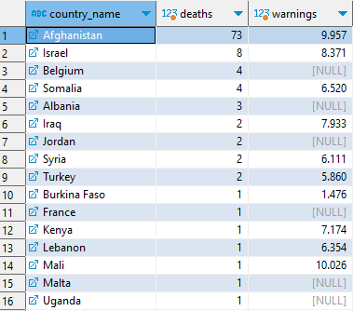
Query 8 - Comparison terrorism - warnings by country 1/2
The phenomenon of terrorism has been at the center of the international debate for more than 20 years. Including all the countries of the world, Afghanistan is found to be the country with the highest terrorist risk with 73 terrorist acts out of 107 recorded.

Slide 26
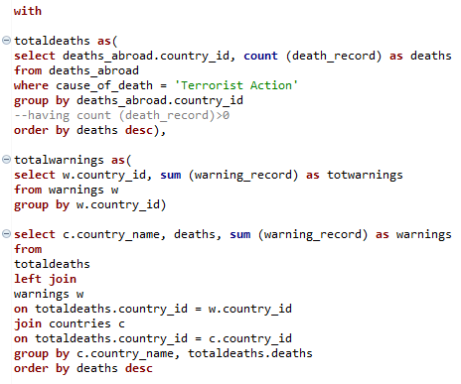
Query 8 - Comparison terrorism - warnings by country 1/2
Again I used CTE (Common Table Expression) to extract data from the deaths_abroad and warnings tables , filtering the results with respect to the cause of death of interest, aggregating each table by country and finally merging the two tables.

Slide 27
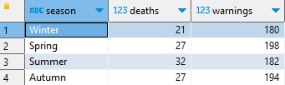
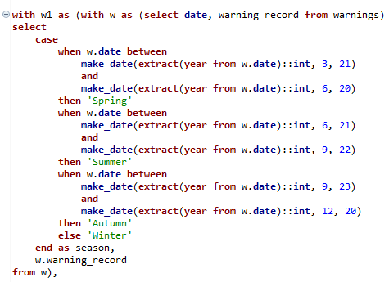
Query 9 – Comparison terrorism - warnings by season 1/3
In this query, the data relating to deaths from terrorist acts were aggregated according to the season¹ with the aim of detecting trends. In the light of the results, no significant trends seem to emerge although a higher number of terrorist acts is observed in the summer than in the winter.
From a structural point of view, this query is completely superimposable on query n.6
¹Season are described according to boreal hemisphere

Slide 28
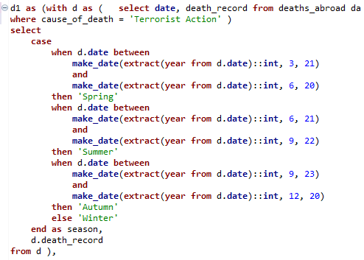
Query 9 – Comparison terrorism- warnings by season 2/3
In this query, the data relating to deaths from terrorist acts were aggregated according to the season¹ with the aim of detecting trends. In the light of the results, no significant trends seem to emerge although a higher number of terrorist acts is observed in the summer than in the winter.
From a structural point of view, this query is completely superimposable on query n.6
¹Season are described according to boreal hemisphere

Slide 29
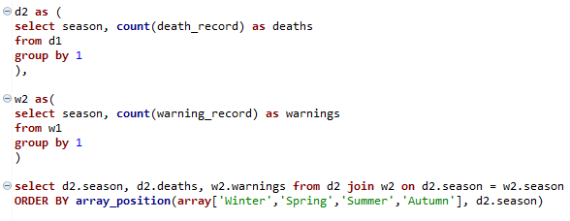
Query 9 – Comparison terrorism- warnings by season 3/3
In this query, the data relating to deaths from terrorist acts were aggregated according to the season¹ with the aim of detecting trends. In the light of the results, no significant trends seem to emerge although a higher number of terrorist acts is observed in the summer than in the winter.
From a structural point of view, this query is completely superimposable on query n.6
¹Season are described according to boreal hemisphere

Slide 30
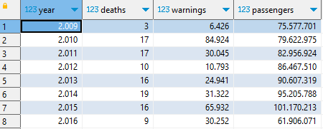
Query 10 – Multiple comparison in the historical series 1/2
In this query, the data relating to deaths from terrorist acts, warnings and passengers were aggregated according to the year of the event with the aim of detecting trends. In the light of the results, a correlation between the three parameters or an evident trend in each of the three parameters does not seem to emerge.
From a structural point of view, this query is completely superimposable on query n.8

Slide 31
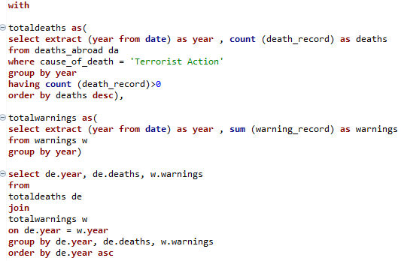
Query 10 – Multiple comparison in the historical series 1/2
In this query, the data relating to deaths from terrorist acts, warnings and passengers were aggregated according to the year of the event with the aim of detecting trends. In the light of the results, a correlation between the three parameters or an evident trend in each of the three parameters does not seem to emerge.
From a structural point of view, this query is completely superimposable on query n.8

Slide 32
Conclusions
The most dangerous country is Thailand
African and Asian countries are both among the safest and most dangerous
The third cause of death abroad is suicide
The most dangerous time to travel is from the end of December to the end of March
DOS warnings don't always represent the most dangerous countries
Afghanistan is the country at highest terrorist risk
There is no evidence of increasing risk of terrorism in the years 2008-2016

Slide 33
Conclusions
This project can be considered a starting point for subsequent analyzes and meta-analyses to be carried out with statistical methods
The results lend themselves to a graphical representation that goes beyond the aim of the current project
Further analysis could be carried out using Python libraries and data visualisation softwares like Power BI or Tableau

